Slide 1


Bang Energy
Integrated Marketing Communications Plan
Ryan Peguero
Southern New Hampshire University
December 17, 2020

Slide 2

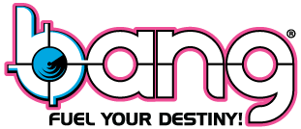
Bang Energy
This group offers a well in-depth view Bang Energy and their marketing efforts
Provides high quality nutritional supplements at a low cost
Backed with scientific research
(Bang.com, 2020)
Notes:
Group 5 has done extensive research to offer you an in-depth review of Bang Energy’s marketing efforts with adding in our own recommendations for solidifying their overall campaign. Bang’s brand statement is to provide high quality nutritional supplementals at a price that consumers don’t feel cheated or ripped off. Scientific Research can prove that Bang Energy is the better option on the market compared to the deceptive practices used by competitors or other supplement companies. Bang Energy was created with the sole purpose to avoid misleading consumers of energy products and help them avoid scams from other supplement companies. “One of the biggest protein manufacturers in the world was recently tested to be 30% under protein claimed on the label and also contained 30% of what I refer to as “non-protein filler”. Compare that to our SRO™ Zero Carb® Protein which contains the highest protein content per pound and per ounce! Further scams are evident by the largest seller of ready to drink protein beverages that tested 32% under label claim. This is insane my friends. There is a willful and purposeful intent to rip you off. Worse yet, you have to wonder what the hell is in these products that you are drinking that isn’t protein!” (Bang, 2020).

Slide 3

Situational Analysis & Audience Research
Geographic & Demographic
Psychographic
Offered in all parts of the United States
Male and Female
Early 20’s to mid 30’s
Has expendable cash
Looking for healthier energy drinks
Enjoys flavors that pop
Exercises daily
Drives for extended periods
(gettyimages.com, 2020)
Notes:
The ideal consumer lives in the U.S. We were looking at both male and females from the their early 20’s to their mid 30’s. They have expendable cash to purchase these energy drinks. They are also looking for a healthier option to the leading energy drinks to use during their workouts or long travels. And they mind a nice flavor that just pops out from the rest of them.

Slide 4

SWOT Analysis
Strength | Weakness
Appealing flavors for each customer’s taste pallets Brand Identity (attractive packaging) Competitive pricing | Contains high levels of caffeine Fairly new to the market Saturated energy drink market
Influencers to promote the product New distribution deals with PepsiCo Brand Identity New product | Competing for consumers with other well-known energy drink brands Health-conscious community would push away from energy drinks Research against energy drinks
Opportunity | Threat
Notes:
Bang Energy has many factors that play into its success. Their strengths include being the healthier option of all the energy drinks out there, along with competitive pricing, and a good brand identity.
Their weaknesses, however, is that they are in a over saturated market and they are fairly-new to this market.
But they can overcome those weaknesses with the proper opportunities, such as their new distribution deal with PepsiCo.
A big threat to Bang Energy is their competitors. Big names like Red Bull and Monster Energy. And research has shown that overconsumption of energy drinks has a direct correlation to heart attacks and seizures. And the New York Times has listed it as one of the most dangerous energy drinks out there.

Slide 5
Strategic Objectives
Specific
Increase Sales
Increase Social Media Presence
Measurable
Look at sales from previous months
Check social media presence with KPIs
Attainable
Increase advertising with developed copies
Relevant
Time-Bound
Increasing sales and social media presence will lead to Bang being the number one company in the market
2 months of circulating the IMC
Monthly review of sales and KPIs for three months
Notes:
These smart goals were devised from the following strategic objectives:
Increase sales by 10% by year end using social media influencers to reach target market
Monitor social media metrics with custom hashtag e.g., #bangforyourbuck
Maintain a consistent social media presence by scheduling posts in advance to ensure there is a post made every day or every other day.
Educate target audience through social media posts and be transparent about the effects of the over consumption of energy drinks
Increase social media presence by 5% within 2 weeks
Build customer loyalty by 15% within 3 months
Use KPIs to check the improvement of the brand on a weekly basis
Offer limited time coupons (2-week period) for a bulk deal
The ultimate purpose for the smart goals besides increasing the sales and social media presence was to build customer loyalty and push Bang Energy to becoming the number one energy drink company on the market.

Slide 6
Creative Brief
Why are we advertising
To promote Bang Energy drinks as the best and healthier alternative for your source of energy
To whom are we talking to?
Those who are interested in fitness and working professional
What do they currently think?
All energy drinks taste the same and have the same effect
What would you like them to think?
Bang will supersede in performance and energy when presented with the issue
What is the most persuasive idea we can convey?
Bang is the healthier option when compared to its competitors
Why should they believe it?
Bang has proven with its ingredients that they are the healthier choice
Are there any creative guidelines or mandatories?
Bang logo
Tone of voice?
Energetic and motivating
Notes:
The whole creative brief is basically stating that we are trying to promote Bang as the best and overall healthier energy drink on the market to our consumers, and anyone that is skeptical of our product. We are trying to do this with an energetic and motivating tone to convey the same energy that Bang Energy drinks would give you.

Slide 7
Key Messages
Best quality nutritional supplements
Raw materials are quarantined and tested
Bang takes pride in quality control
Notes:
Some key messages to take from Bang Energy is that they offer the best quality nutritional supplements and is backed by scientific research. Their CEO, sets very high standards for the company and product alike. All their raw materials are quarantined and tested for their efficiency once received in their warehouse. And they take a lot of pride in their transparency with the labels and their quality control.

Slide 8

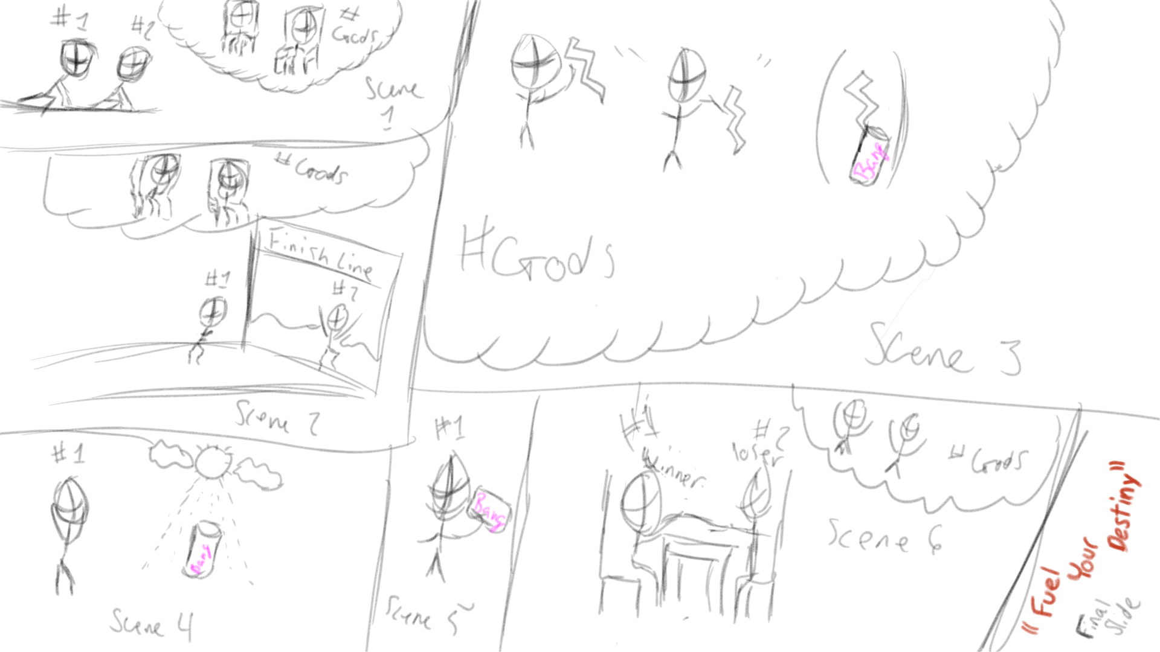
Online Sketch & Script/Copy
Notes:
With this first ad we are presenting Bang Energy drink as something made from Zeus in Ancient Greece.
The Scene starts out in Ancient Greece.
It pans over the great City of Olympia, where the Olympic athletes are stretching
The camera zooms in on the athlete that is favored by the Gods
He is sluggish and constantly falling behind in every event
Zeus gets upset and throws one of his lightning bolts into a container of water
The favored athlete sees the sparkling beverage in the distance
He approaches it and drinks it
His energy and stamina are immediately rejuvenated, and he wins his final event
Camera pans up: and features the tagline “Fuel Your Destiny”

Slide 9
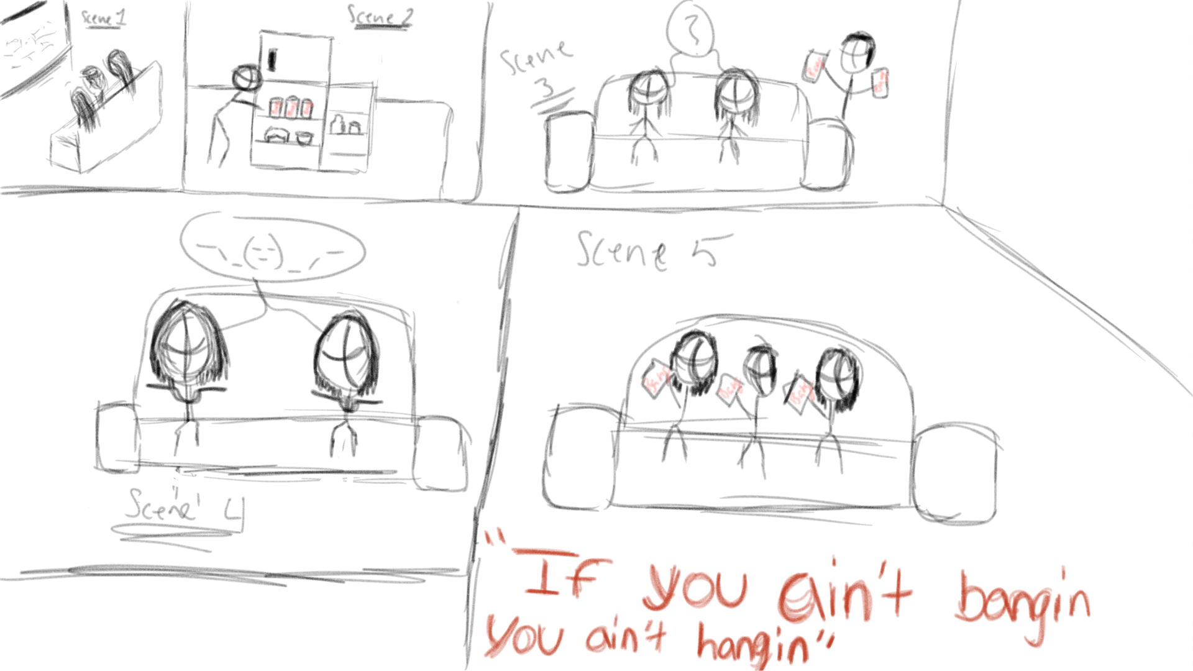
TV Sketch & Copy
Notes:
This ad portrays three friends watching tv while one of three gets up and goes to the kitchen to get something form the fridge.
Three friends spending time together laughing watching tv, one gets up during a commercial and walks to the kitchen opens the fridge and sees three Bang’s.
Friend one (male): “hey you guys wanna bang?”
Friend two & three (female): Shockingly look at each other in confusion
& reply “what?!”
Friend one: “Do you guys wanna bang?”
Friend two & three: contemplating
Friend one: appears back with the other two friends holding three bang drinks....”anyone want a bang or...?” -”if you ain’t bangin you ain’t hanging”.
Friend two & three: accept drinks and go back to watching tv *everyone laughs
The Camera pans out and reveals the tagline “If You Ain’t Bangin, You Ain’t Hangin”

Slide 10
Radio Copy
Tired of these useless energy drinks taking your money and leaving you groggy? Say no more and welcome Bang, the next best thing since sliced bread.
Bang Energy drinks packs a better punch than other leading brands but doesn’t leave you feeling tired and mopey mid-workout.
And the best thing is that it is half the price of the competition.
And better yet they offer a wide variety of flavors for you to enjoy from each packed with natural flavors, 0 calories, 50% Vitamin C and 25% Vitamin B6!
So, what are you waiting for come and get “more Bang for your Buck!”
The instrumental to Ozzy Osborne’s ‘Crazy Train’ plays in the background faintly while narrator starts reading advertisement script

Slide 11
IMC Recommendations
Have a cohesive marketing campaign with attention to detail
Solidify their position as the healthier option compared to competitors
Notes:
The overall strategy is to solidify their position as the better, healthier option compared to the competition. It is important that their marketing campaign is cohesive, and that they stay true to their mission and vision statement.
Mission statement (current) for Bang Energy: To make the highest quality nutritional supplements on the market, backed by scientific research.
Vision statement developed for Bang Energy: It is the vision of Bang Energy to provide consumers with the highest and healthiest products that will bring them closer to their personal goals knowing exactly what they are putting into their bodies and what they can expect to get out of them for the best performance and energy.

Slide 12

Questions, Comments, or Concerns
Contact Us
Ryan.peguero@snhu.edu
Bangenergy.com/contact-us/

Slide 13
References
Allied Market Research. (2020). Energy drinks market size, share & demand | Industry analysis 2026. https://www.alliedmarketresearch.com/energy-drink-market
Bang Energy. (2020). About Us. Bang Energy. https://bangenergy.com/about/
Cash, M. (2019, Feb. 26). There’s now an energy drink that taste like rosѐ, and you can buy it for less than $3 a can. Insider. https://www.insider.com/bang-energy-drink-new-rose-flavor-2019-2
Cision. (2018, Sep. 26). Jack Owoc’s Bang Energy hits #1. PRNewswire. https://www.prnewswire.com/news-releases/jack-owocs-bang-energy-hits-1-300719504.html
Getty Images. (2020). Woman running on country road. Getty Images. https://www.gettyimages.com/detail/photo/woman-running-on-country-road-royalty-free-image/748342297
Hall, B. (2018, November 5). Are bang energy drinks healthy? STACK. https://www.stack.com/a/are-bang-energy-drinks-healthy

Slide 14
References Cont.
Harfmann, B. (2020, June 24). 2020 state of the beverage industry: Energy drinks, mixes maintain steady growth. Beverage Industry | Trends, Formulations, Technology & Products. https://www.bevindustry.com/articles/93233-state-of-the-beverage-industry-energy-drinks-mixes-maintain-steady-growth
Harty, P. S. Effects of Bang (R) Keto Coffee Energy Drink on Metabolism and Exercise Performance in Resistance-Trained Adults: A Randomized, Double-blind, Placebo-controlled, Crossover Study. JOURNAL OF THE INTERNATIONAL SOCIETY OF SPORTS NUTRITION, 17(1). https://doi-org.ezproxy.snhu.edu/10.1186/s12970-020-00374-5
Lean, R. (2020, July 08). Lawyers gear up as fight between Bang and Monster Energy drink Advances to trial – a few claims lighter. Law. https://www.law.com/dailybusinessreview/2020/07/08/lawyers-gear-up-as-fight-between-bang-and-monster-energy-drink-advances-to-trial-a-few-claims-lighter/?slreturn=20201009183706

Slide 15
References Cont.
Peltz, J.F. (2019, Apr. 3). Monster energy drink maker expands lawsuit against rival Bang. Los Angeles Times. https://www.latimes.com/business/la-fi-monster-energy-bang-lawsuit-20190403-story.html
Prokop, H. (2020, Apr. 28). PepsiCo, Bang Energy maker enter into exclusive distribution agreement. CSPDailyNews. https://www.cspdailynews.com/beverages/pepsico-bang-energy-maker-enter-exclusive-distribution-agreement
Schall, J. (2019, Jun. 30). The Bang Energy Effect. Medium. https://medium.com/@joshua_schall/the-bang-energy-effect-2deabba50019
Wassef, B., Kohansieh, M., & Makaryus, A. N. (2017). Effects of energy drinks on the cardiovascular system. World journal of cardiology, 9(11), 796–806. https://doi.org/10.4330/wjc.v9.i11.796

